Slide 1
Naive Bayes Method
Understanding and implementing probabilistic classification using Bayes Theorem

Slide 2
Contents
01
02
About Naive Bayes Classifier
Conditional Probability Fundamentals
03
04
Bayes Theorem
Naive Bayes Framework
05
06
Classification Rule
Advantages and Limitations of Naive Bayes Method
07
08
Handling Zero Probabilities
Naive Bayes in Python and Laplace Smoothing

Slide 3
About Naive Bayes Classifier
Probabilistic Foundation
Simple probabilistic classifier based on Bayes Theorem, providing a mathematical framework for classification problems
Alternative to Logistic Regression
Can be used as an effective alternative method to binary or multinomial logistic regression
Independence Assumption
Assumes conditional independence among the predictors, simplifying probability calculations
High-Dimensional Data
Particularly suited when the dimensionality of the inputs is high, making it ideal for complex datasets
Despite its simplicity, Naive Bayes can often outperform more sophisticated classification methods

Slide 4
Conditional Probability Fundamentals
Understanding Sample Space
Conditional probability measures the likelihood of an event occurring given that another event has already occurred. When event A has happened, the sample space becomes restricted to only those outcomes where A is true.
For example, if we have 5 points in our sample space and event A has occurred, we only consider set A when calculating probabilities of other events.
Mathematical Definition
The probability of event B given event A is written as P(B|A) and calculated by dividing the probability of both events occurring by the probability of A:
P(B|A) = P(A ∩ B) / P(A)
This formula forms the foundation for understanding Bayes Theorem and its applications in classification.

Slide 5
Bayes Theorem
P(A|B) = [P(B|A) × P(A)] / P(B)
P(A|B)
Posterior Probability
The probability of A given that B has occurred - what we want to calculate
P(B|A)
Likelihood
The conditional probability of B given A - our evidence
P(A)
Prior Probability
The marginal probability of A before considering B
P(B)
Marginal Probability
The prior or marginal probability of B - our normalizing constant

Slide 6
Naive Bayes Framework
Core Components
Y: Categorical Dependent Variable - the class we want to predict
Xi: Categorical or Continuous Independent Variables - the features used for prediction
Classification Formula
The Naive Bayes classifier applies Bayes Theorem with the "naive" assumption that all features are conditionally independent given the class label.
For a given set of features X₁, X₂, ..., Xₙ, we calculate:
P(Y|X₁, X₂, ..., Xₙ) ∝ P(Y) × ∏P(Xi|Y)

Slide 7
Naive Bayes Framework - Example Setup
Consider a simple binary classification problem predicting whether someone will be a buyer or non-buyer based on demographic characteristics.
Define the Response Variable
Y = 1 represents "Buyer"
Y = 0 represents "Non-Buyer"
2. Define Age Variable (X₁)
X₁ = 0 for age group 25-30 years
X₁ = 1 for age group 31-40 years
3. Define Gender Variable (X₂)
X₂ = 0 if Gender = female
X₂ = 1 if Gender = male

Slide 8
Classification Rule
Decision Criterion
To classify a new observation, we calculate the posterior probability for each class given the observed features.
The observation is assigned to the class with the highest posterior probability:
Classify as Y = 1 if P(Y=1|X₁,X₂) > P(Y=0|X₁,X₂)
Classify as Y = 0 otherwise
Probability Calculation
Using Bayes Theorem and the independence assumption:
P(Y=1|X₁,X₂) = P(X₁|Y=1) × P(X₂|Y=1) × P(Y=1) / P(X₁,X₂)
We estimate these probabilities from the training data by calculating relative frequencies in each category.

Slide 9
Expected Output
Once the classification rule is applied, the output displays predicted probabilities for each class and the final classification decision.
Case# | X₁ | X₂ | P(Y=1|X₁,X₂) | P(Y=0|X₁,X₂) | Y classified as
1 | 1 | 0 | 0.44 | 0.56 | 0
2 | 1 | 1 | 0.70 | 0.30 | 1
… | … | … | … | … | …
240 | 0 | 0 | 0.20 | 0.80 | 0
The table shows how each observation is assigned probabilities for both classes, with the final classification based on which probability is higher.

Slide 10
Advantages of Naive Bayes Method
1. Simple and Interpretable
Classification rule is straightforward to understand and explain, making it accessible for both technical and non-technical audiences
2. Efficient Training
Requires a small amount of training data to estimate the parameters necessary for classification, making it suitable for limited datasets
3. Fast Evaluation
The evaluation of the classifier is quick and computationally efficient, enabling rapid predictions on large datasets
4. Effective Alternative
Can serve as a good alternative to logistic regression, often performing comparably or better with less computational overhead

Slide 11
Limitations of Naive Bayes Method
Independence Assumption
The assumption of conditional independence among independent variables is strict in real-world scenarios where features often correlate
Distributional Assumptions
For continuous independent variables, the density function must be known or assumed (typically normal distribution), which may not reflect reality
Zero Probability Problem
For categorical variables, probabilities cannot be calculated if the count in any conditional category is zero. For example: if there are no respondents in age group 25-30 years,
then P(X₁=0|Y=1) = 0, making the entire probability expression zero

Slide 12
Handling Zero Probabilities
?
The Problem
What happens when a category has zero entries in the training data?
The Solution: Smoothing
To avoid zero probabilities, we add a constant to each category count before computing conditional probabilities.
The technique based on above concept, known as Laplace smoothing or additive smoothing, prevents the entire probability from collapsing to zero due to a single missing category.

Slide 13
Laplace Smoothing
What is Laplace Smoothing?
Laplace smoothing, also called additive smoothing, addresses the zero-probability problem by adding a small constant to all category counts.
In scikit-learn's MultinomialNB, this is controlled by the alpha parameter.
Implementation
# With Laplace smoothing
MNBmodel=MultinomialNB(alpha=1.0)
MNBmodel.fit(X_train, y_train)
alpha = 1.0: Standard Laplace smoothing
alpha = 0: No smoothing
alpha > 1.0: More aggressive smoothing
Laplace smoothing ensures robust probability estimates even when certain feature-class combinations are absent from the training data, preventing model breakdown and improving generalization.

Slide 14
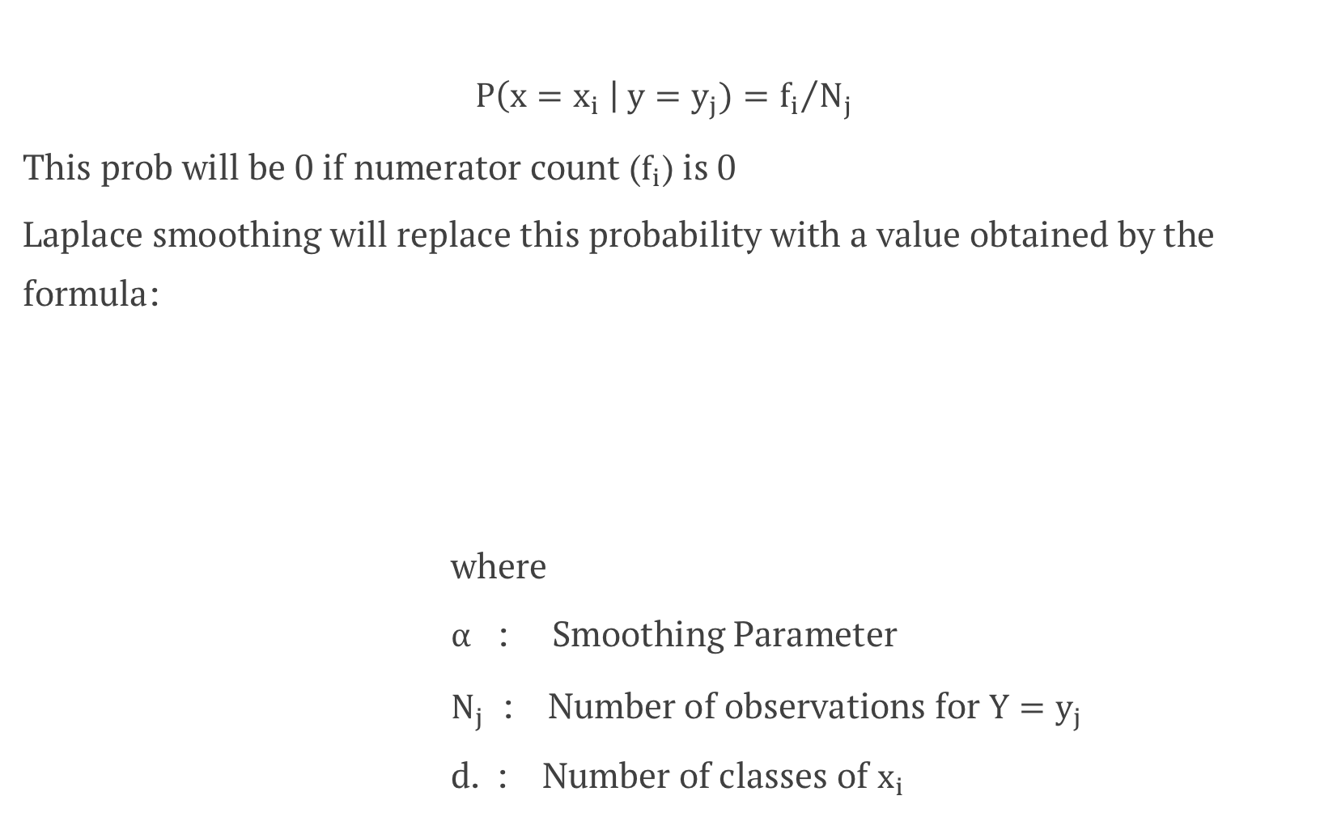

Laplace Smoothing
$$P\left(x=x_{i} \right| y=y_{j})={f_{i}}/{N_{j}}$$
This prob will be 0 if numerator count ($f_{i}$) is 0
Laplace smoothing will replace this probability with a value obtained by the formula:
where
$α$ : Smoothing Parameter
$N_{j}$ : Number of observations for ${Y=y}_{j}$
d. : Number of classes of $x_{i}$
$$\hat{θ}i=\frac{f_{i}+α}{Nj+αd}$$

Slide 15
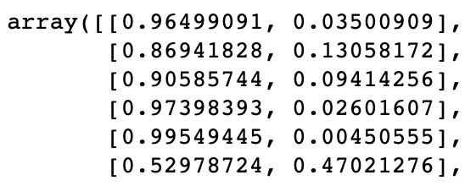
Naive Bayes in Python: Continuous Predictors
Model Fitting with GaussianNB
# Import the model
from sklearn.naive_bayes import GaussianNB
# Initialize and fit the model
NBmodel = GaussianNB()
NBmodel.fit(X_train, y_train)
GaussianNB() fits a Gaussian Naive Bayes algorithm for classification. This model is suitable for continuous predictors and assumes the likelihood of predictors follows a normal distribution.
Generating Predicted Probabilities
# Get predicted probabilities for test data
predprob_test = NBmodel.predict_proba(X_test)
predprob_test
predict_proba() returns the predicted probabilities for each class in the test data, allowing you to see the model's confidence in its predictions.

Slide 16
Naive Bayes in Python: Categorical Predictors
Model Fitting with MultinomialNB
# Import the model
from sklearn.naive_bayes import MultinomialNB
# Initialize and fit the model
MNBmodel = MultinomialNB(alpha=0)
MNBmodel.fit(X_emp, y_emp)
MultinomialNB() fits a Multinomial Naive Bayes algorithm specifically designed for classification with categorical predictors.
The parameter alpha = 0 doesn't apply any smoothing on the data. When alpha > 0, it applies Laplace smoothing to handle zero probabilities. The default value is alpha=1.

Slide 17
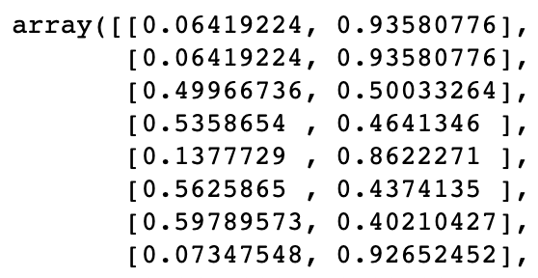
Generating Predictions for Categorical Data
Predicted Probabilities
# Get predicted probabilities
predprob_MNB = MNBmodel.predict_proba(X_emp)
predprob_MNB
The predict_proba() method returns a matrix where each row corresponds to an observation and each column represents the probability of belonging to each class.
Understanding the Output
The output is a numpy array with shape (n_samples, n_classes). Each row sums to 1.0, representing the complete probability distribution across all classes for that observation.
Higher probability values indicate greater confidence in the prediction for that particular class.

Slide 18
Laplace Smoothing
What is Laplace Smoothing?
Laplace smoothing, also called additive smoothing, addresses the zero-probability problem by adding a small constant to all probability counts.
In scikit-learn's MultinomialNB, this is controlled by the alpha parameter.
Implementation
# With Laplace smoothing
MNBmodel=MultinomialNB(alpha=1.0)
MNBmodel.fit(X_train, y_train)
alpha = 1.0: Standard Laplace smoothing
alpha = 0: No smoothing
alpha > 1.0: More aggressive smoothing
Laplace smoothing ensures robust probability estimates even when certain feature-class combinations are absent from the training data, preventing model breakdown and improving generalization.

Slide 19
Naïve Bayes Method: Key Takeaways
What is Naïve Bayes Method?
The Naïve Bayes Method is used in classification problems.
The class probabilities ate computed using Bayes' theorem,.
Python Functions
GaussianNB for continuous predictors and MultinomialNB for categorical predictors.
Types of Variables
The dependent variable is a categorical variable ( Nominal Scale) whereas independent variables can be numeric or categorical.
Laplace Smoothing
Addresses the zero-probability problem by adding a small constant to all probability counts

